Slide 1
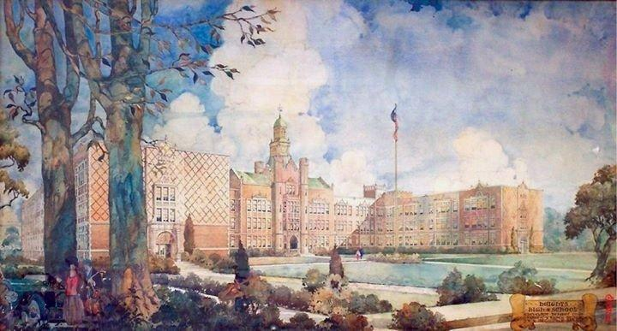
Cleveland Heights – Neighborhood Meeting
January 7, 2015

Slide 2
Building Plan
Building has Four Levels:
- Ground (Washington Level)
- First (Cedar Level)
- 2nd, 3rd, 4th (Existing 1926)
Original 1926 Core remains
One main entrance for students (car drop-off) and public
Secondary entrance (historic) for students (walkers and bus riders)
P.E./Athletics + pool on Washington Level
Main administrative area, entrances and public spaces on Cedar Level
Special education suite on Cedar Level
Building is totally ADA accessible
CTE spaces integrated into plan
Core academic spaces on 2nd and 3rd Floors

Slide 3
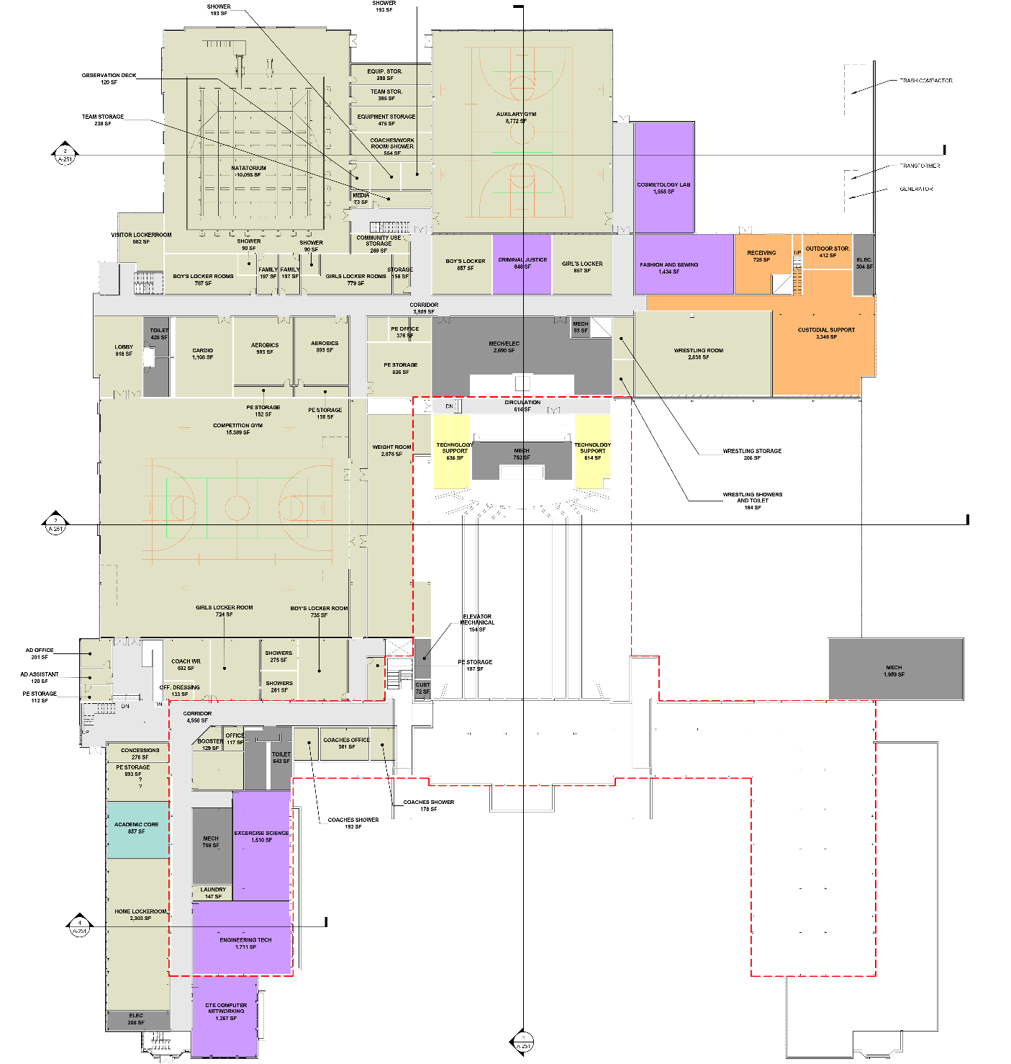
Lower Level Floor Plan (Washington Level)

Slide 4
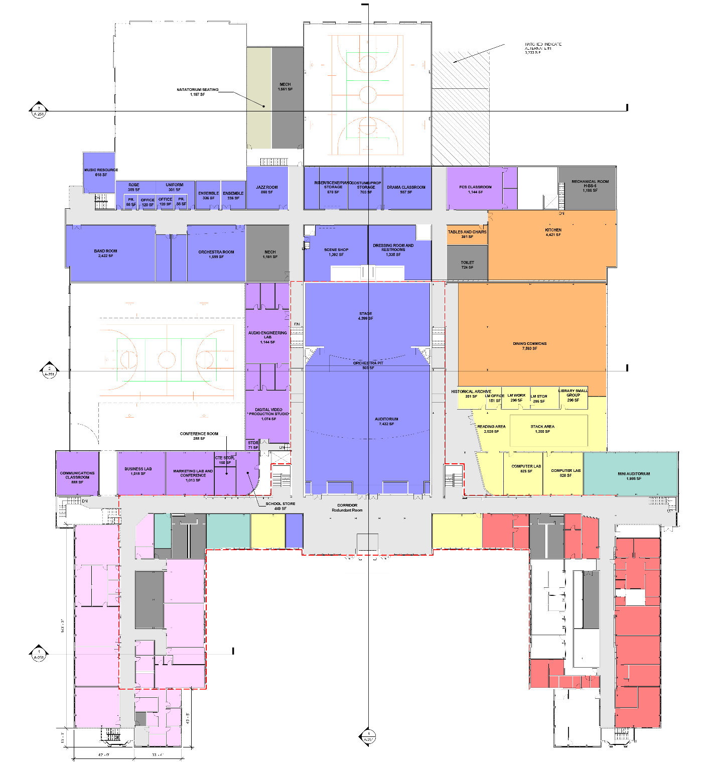
First Floor Plan (Cedar Level)

Slide 5
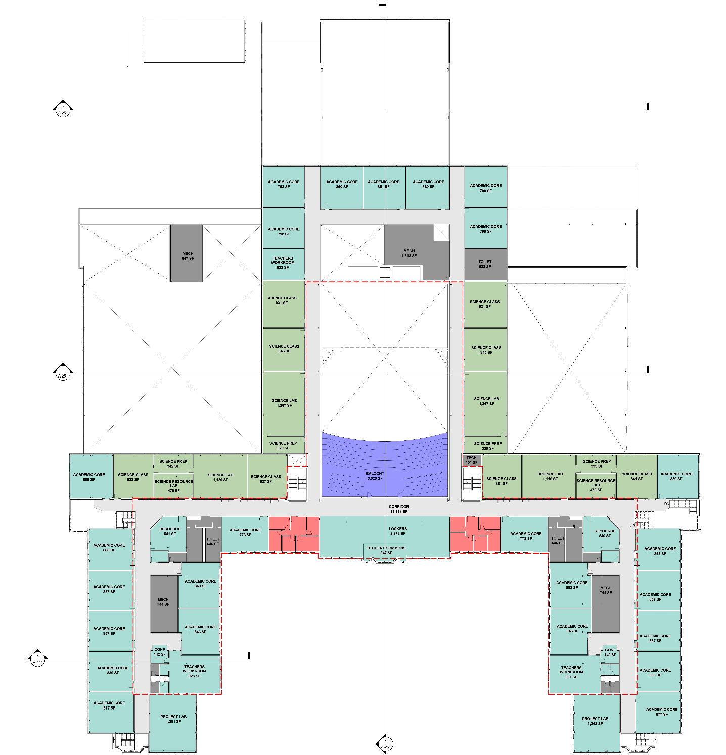
2nd Floor Plan

Slide 6
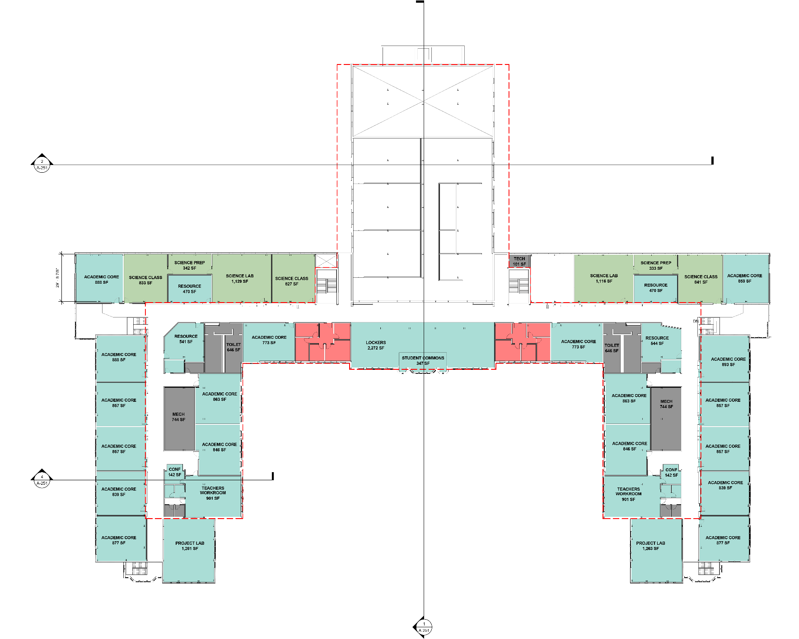
3rd Floor Plan

Slide 7
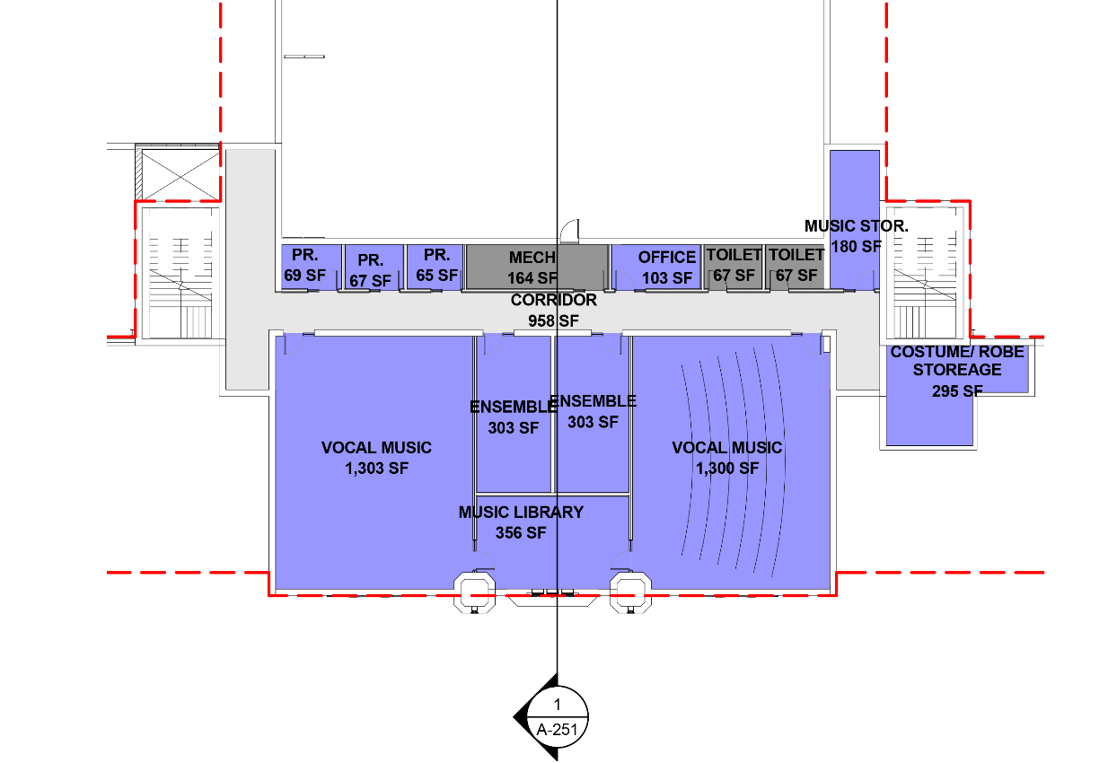
4th Floor Plan

Slide 8
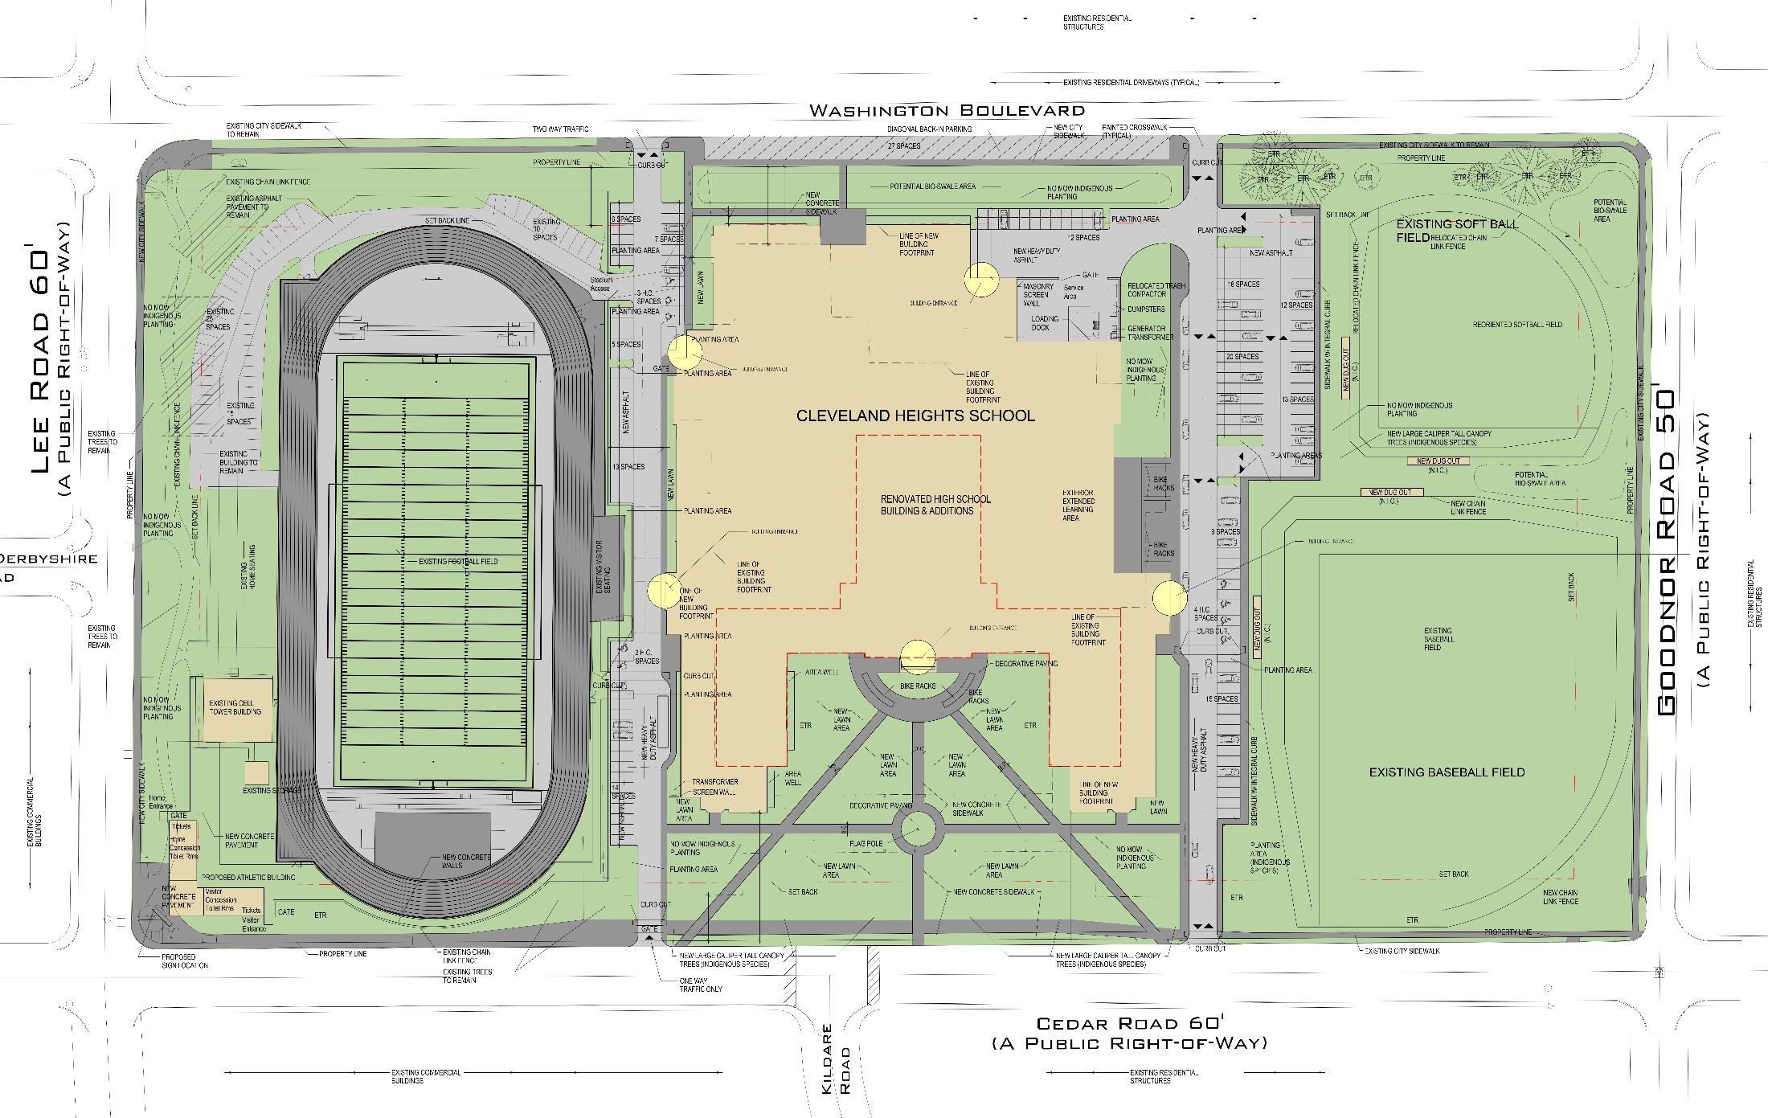
Site Plan
Existing Building
Traffic Flow

Slide 9
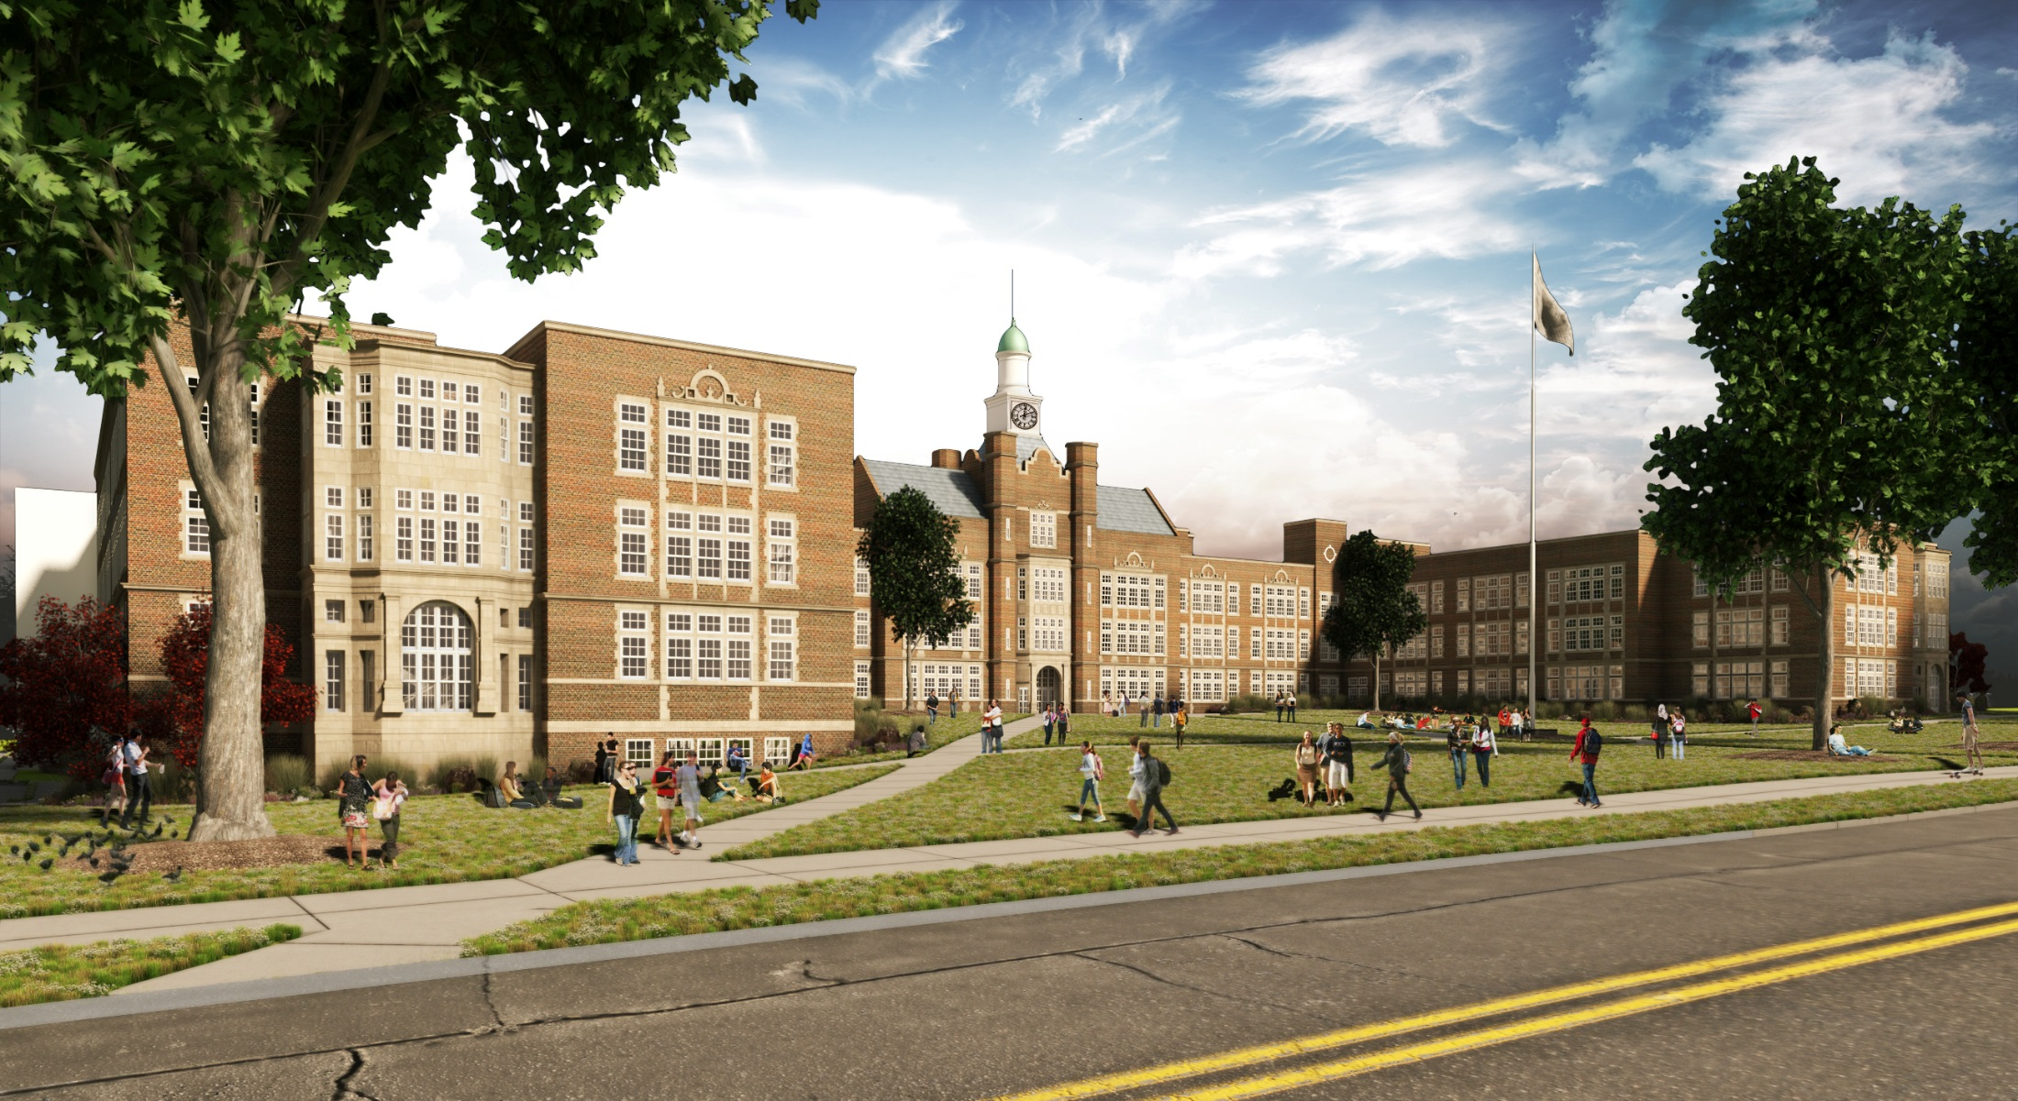
Southwest Perspective

Slide 10
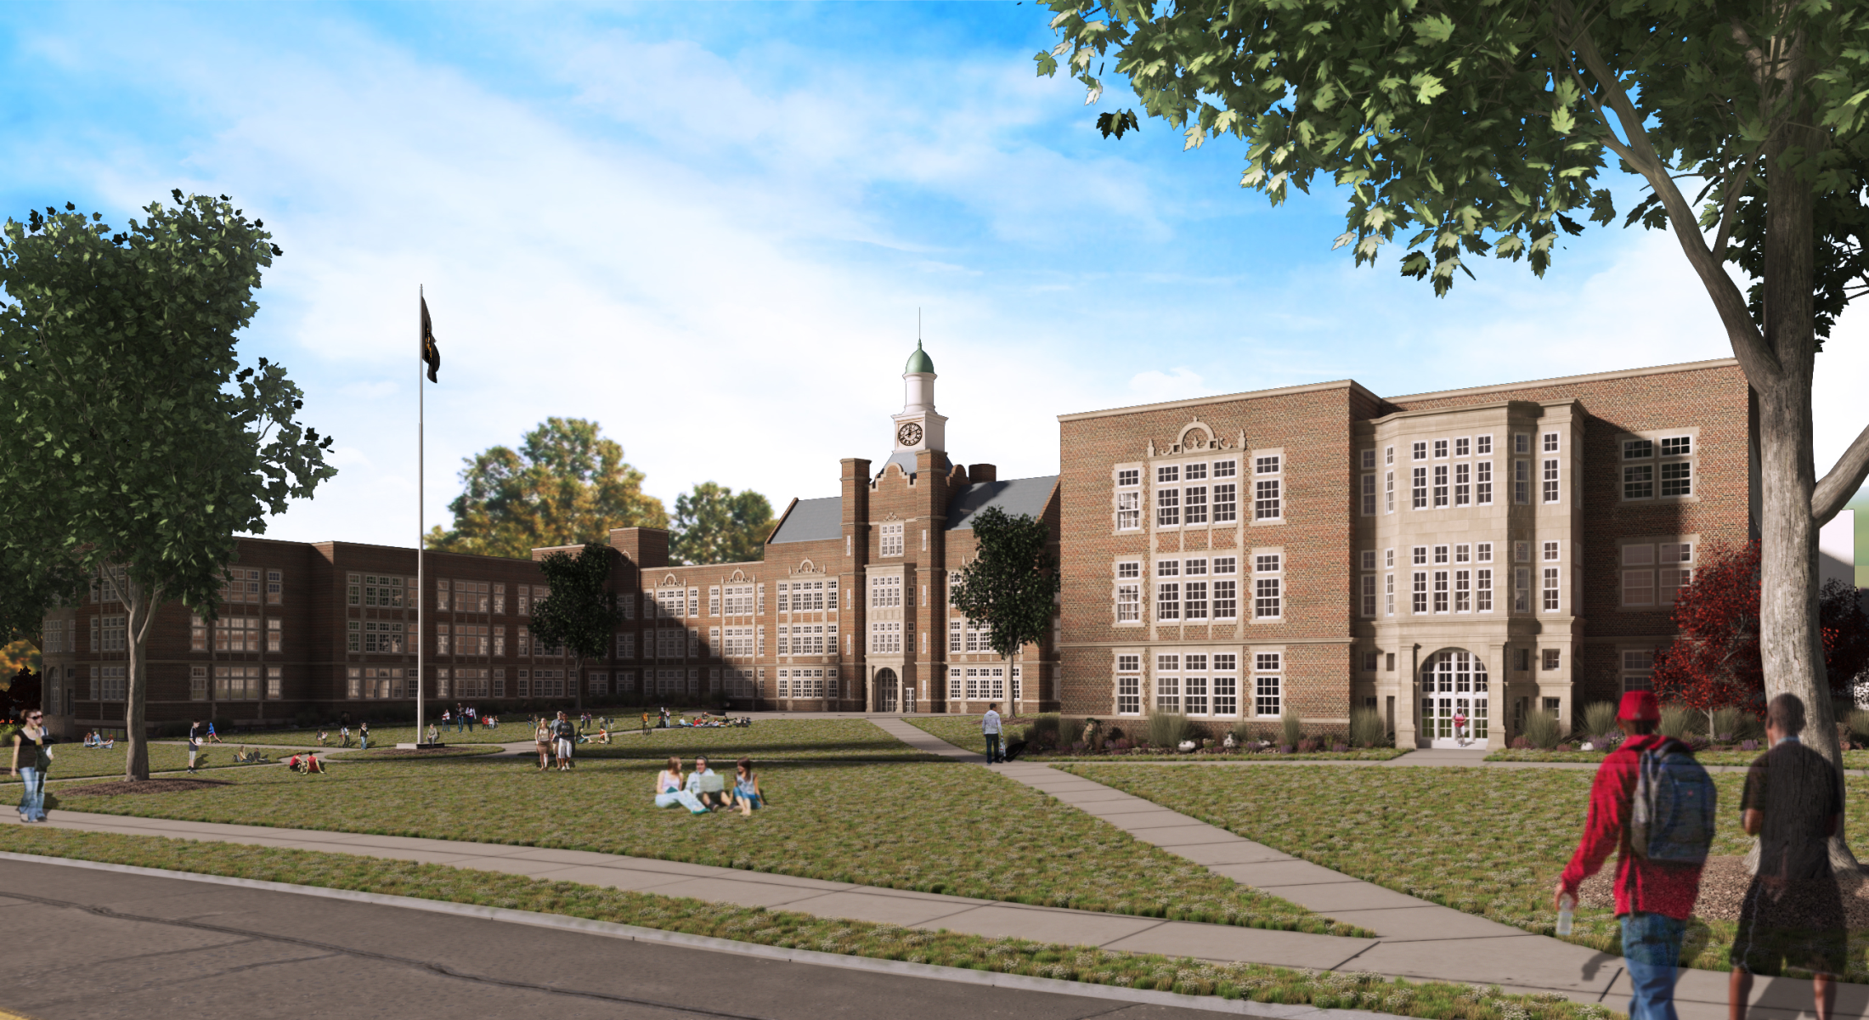
Southeast Perspective

Slide 11
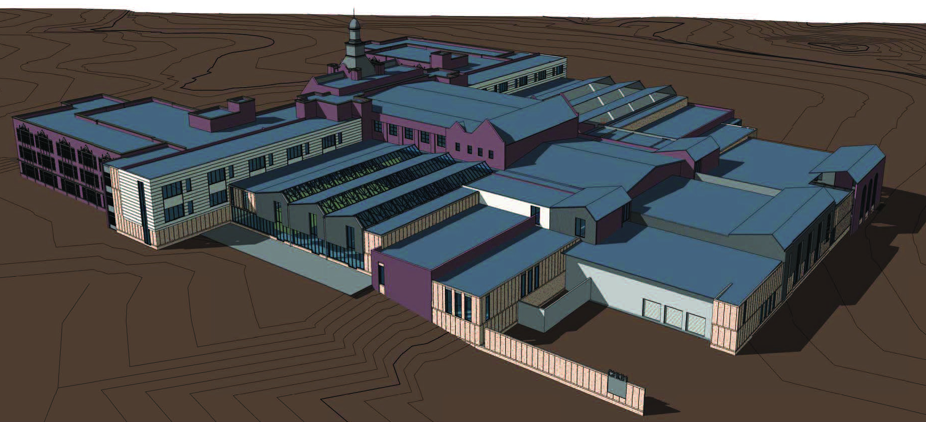
Northeast Perspective

Slide 12
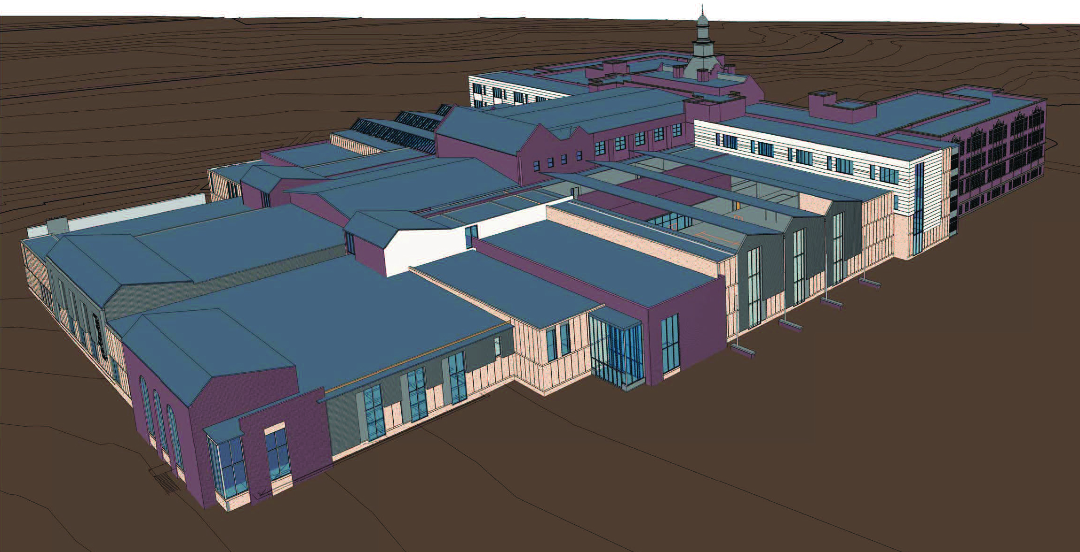
Northwest Perspective

